Slide 1
Tailored for your team.

Slide 2
Our Roots
Before Ukrop’s Threads we were a family-owned grocery chain, Ukrop’s Super Markets.
We were passionate about customer-service and quality and dedicated to giving back to the community.
As we grew, uniform suppliers weren’t giving is the service and customization we needed.

Slide 3
Uniforms leave a big impression about your brand, reflect your culture, and make your employees feel good.

Slide 4
Ukrop’s Threads Today
From concept to manufacturing and distribution, we provide a complete uniform solution.
Corporate office & warehouse in Midlothian,VA
139 staff
1,000,000 customers across the USA annually
On the board of Caritas
Uniforms, branded apparel & promotional products
8 global sourcing relationships & 14 domestic suppliers

Slide 5
Peace of mind service.
Client name here
Let us put your image to work.

Slide 6
We are driven to be admired for our people, performance, and relentless pursuit of excellence.
Our goal is to enable you to promote your brand and employees.
We do this by leading with personal service and providing fully customized, competitively priced, and high-quality programs.

Slide 7
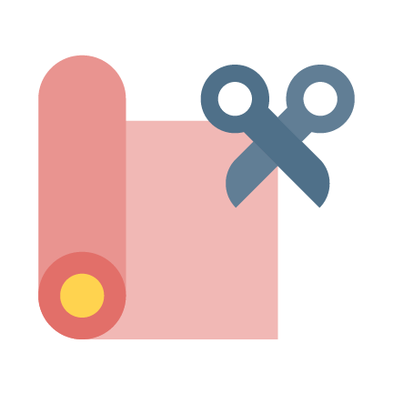
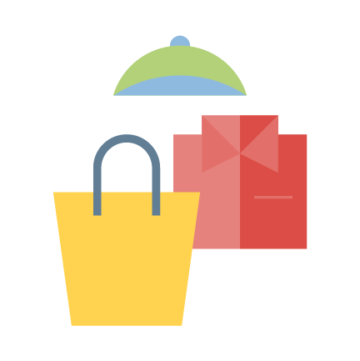
Design
Think outside the catalogue and get what you want.
Graphic Design
Through in-depth consulting with your team we create design concepts for your new look.
Custom Fit
With our ability to tailor fit, your staff will be comfortable and your brand well-represented.
Fabric Options
Moisture-wicking, snag resistant, and environmentally friendly fabrics can be customized for you.
Marketing Collateral
We can extend your brand with promotional gear, t-shirts, rewards and recognition programs, and the like.

Slide 8
Design
Completely custom
PMS color match
Costs less
Uniforms, marketing collateral, promotional items

Slide 9
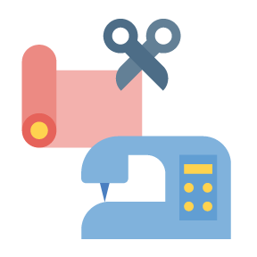
Design: Our Process
Discovery
Focus groups
Asset gathering
Brand audit
Creative Exploration
Mood boards
Storyboards
Samples
Development
Pre-production
Refinements
Final send-off
Performance
Order tracking
Consultations
Enhancements

Slide 10
Global Sourcing
Long standing relationships
Customization
Minimize supply chains
Less expensive
WRAP certified fabrics

Slide 11
Warehouse & Fulfillment
24-48 hour turnaround
99.3% on-time shipping for over 120,000 SKUS
Less than 5% return rate (including no fault returns)
Freight consolidation
No distribution fees
Free uniform storage

Slide 13
IT Solutions
We can develop web-stores, apps, and digital dashboards that are customized to your business and employee needs.

Slide 14
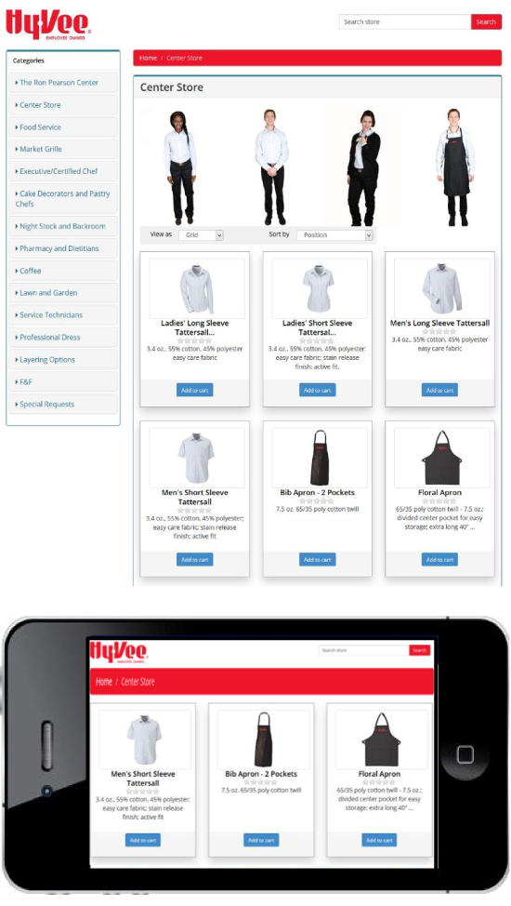
IT Solutions: Web Stores
User friendly webstores make it easy to order new uniforms.
Role-based access
Integrated punch-outs
PCI compliance
Mobile friendly
Integrated reward and incentive programs
Multiple payment options

Slide 15
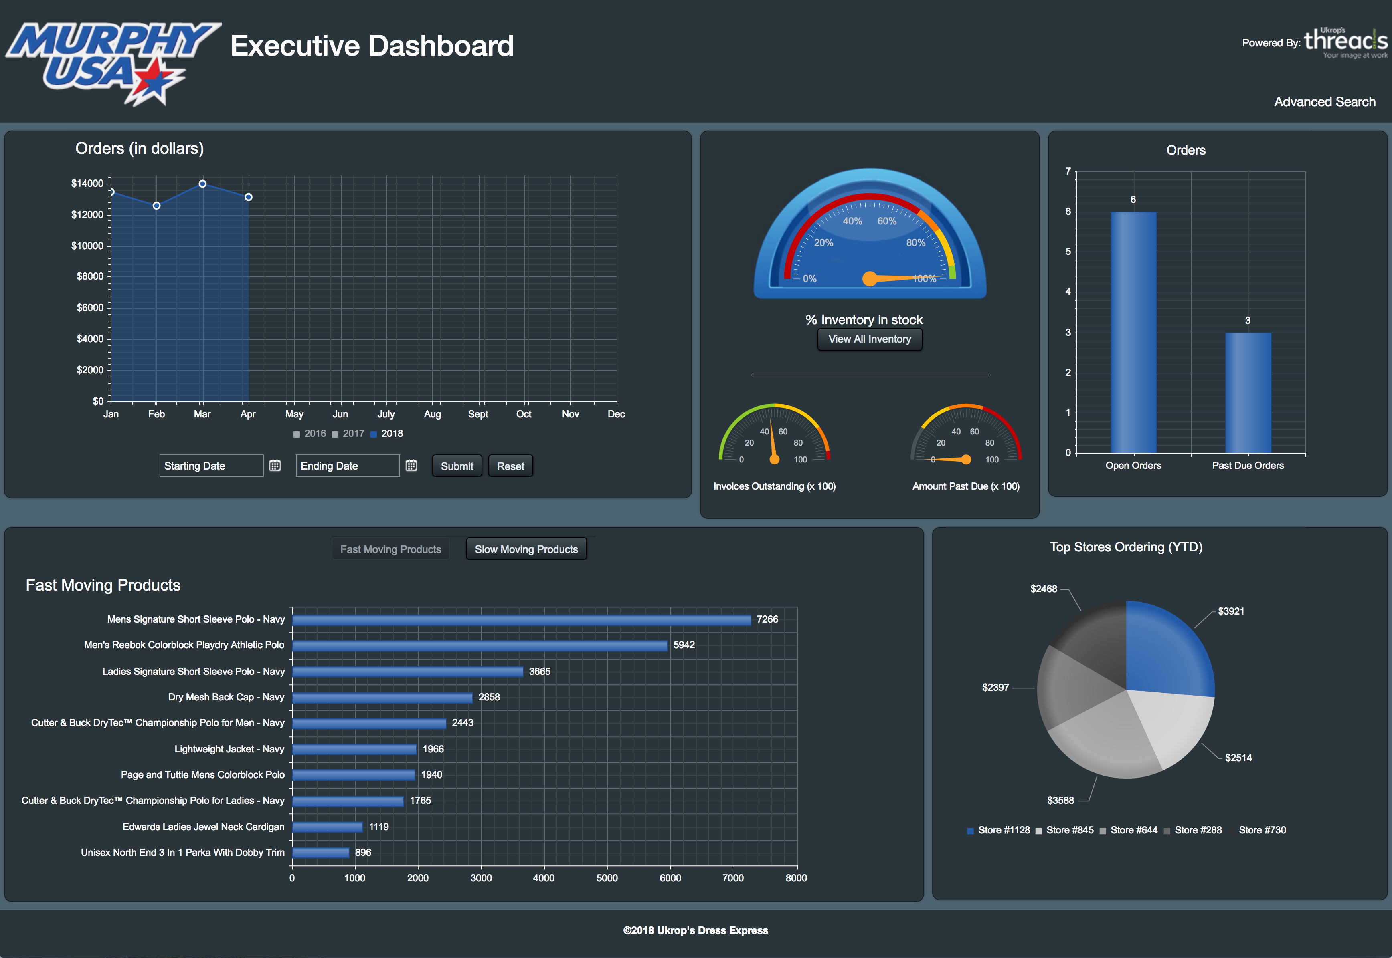
IT Solutions: Custom Dashboards
Your dashboard is like a control center, keeping you up to date on inventory, orders, and more.
Business Intelligence
Robust data mining capabilities
Extensive data reviews
Customizable reports and KPIs
Executive Dashboards
Real-time visual analytics
Intuitive analysis of defined KPIs

Slide 16
Client Services
Personal service is at the heart of what we do.

Slide 17
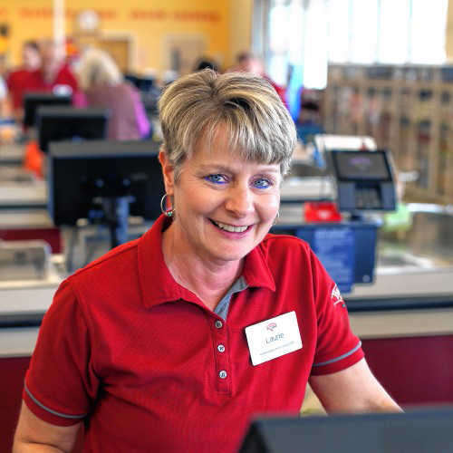
Hannaford Case Study
Problem
Hannaford’s uniforms needed an update both visually and for comfort fit.
Solution
After hearing their needs, we designed a new uniform with updated colors, logos, and fabrics.
Results
Employees were more comfortable in the fit and style of their new shirts. They no longer needed to worry about it fading or shrinking.
“I can always count on Ukrop’s Threads to respond quickly and with great customer service every time we have an ask.”

Slide 18
We do great work for great people.
Uniforms touch every employee and every customer, while carrying the weight of your brand and image.
Theme parks
Convenience stores
Grocery chains
Quick service restaurants

Slide 20
Current Clients
Client | # Locations | # Employees | States
H-E-B | 360 | 90,000 | TX
Hy-Vee | 245 | 85,000 | IL, IA, KS, MN, MO, NE, SD, WI
Speedway | 2730 | 32,000 | CT, DE, FL, GA, IL, IN, KY, MA, MI, NC, NH, NJ, NY, OH, PA, RI, SC, TN, VA, WI, WV
Cumberland Farms | 600 | 6,000 | CT, FL, MA, ME, NH, NY, RI, VT
Cedar Fair | 13 | 42,000 | CA, NC, OH, PA, VA, MI, MN, MO, Canada
SeaWorld | 12 | 22,000 | FL, CA, TX, VA, PA
Other clients: Hannaford, Harris Teeter, Weis, The Fresh Market, Stater Bros, Tesoro (Go Marts)

Slide 21
Ukrop’s Threads brought the expertise we needed to developing our first company-wide uniform program. They were with us every step of the way.
Carey Lenning, Director, Customer Care, Hy-Vee
Ukrop’s Threads has been an outstanding partner for us… all of our employees are really happy with the fit and comfort level of the uniforms that they provide.
Richard Zimmerman, COO, Cedar Fair Entertainment Company
Several factors led us to choose Ukrop’s – great quality, competitive pricing, outstanding customer service, but your people made a real difference.
Evelyn Hinojosa, Commodity Development Manager, H-E-B

